Slide 1

Educational RAG
Question Answering System
From classic to modern Pipeline
Presented By: Jaykumar Chaudhary (2022DC04341)
BITS Examiner: Jayalakshmi Natarajan ma’am
Supervisor: Mr. Lalkar Eknath Chhadawelkar

Slide 2


Why is Educational QA Hard?
Huge amount of academic content (PDFs, handouts, notes) Students today face information overload from a wide variety of course materials, often spread across hundreds of pages.
Students struggle to find precise, contextual answers Locating specific, reliable answers is time-consuming and frustrating with so many unstructured documents.
Classic keyword search is not enough
Simple search tools can’t understand context or academic nuance, often missing the most relevant explanations.

Slide 3

Project Goals
Enable students to ask natural questions over their own study material The system is designed to let users type real questions and get meaningful answers from their course documents.
Compare classic BERT-based QA with modern, modular RAG pipeline We benchmarked a traditional QA setup against a state-of-the-art Retrieval-Augmented Generation approach.
Deliver explainable, context-rich answers The goal is not just to provide answers, but to ensure they are well-explained, context-aware, and trustworthy.

Slide 4
Baseline: Classic RAG Pipeline
Chunking, semantic search (Sentence-BERT + FAISS) User questions are matched to document chunks using vector embeddings for better semantic relevance.
BERT extracts answer span A pre-trained BERT model selects the most likely answer within the top chunk.
Handles edge cases with fallback logic
If the model is uncertain, it falls back to keyword search or the first relevant sentence.

Slide 5
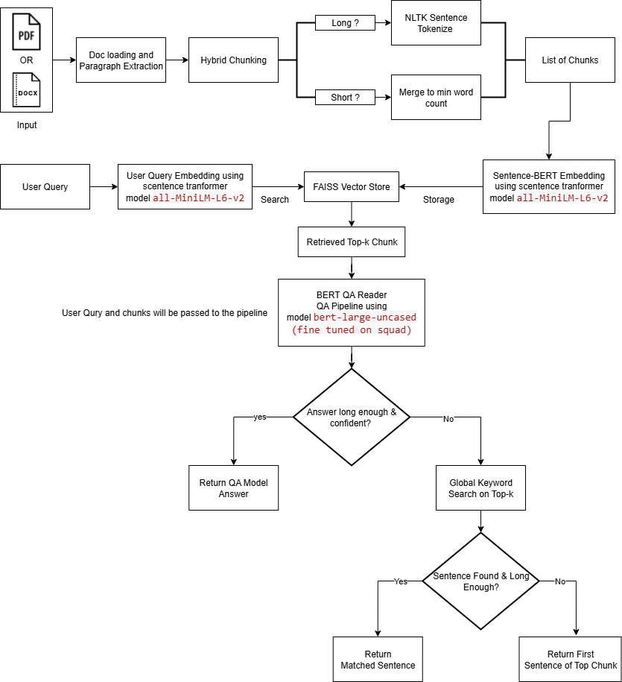
Baseline: Classic RAG Pipeline

Slide 6
Baseline: Classic RAG Pipeline
Demo

Slide 7
Modern Modular RAG Pipeline
Semantic chunking, advanced embeddings (FastEmbed, BAAI/bge-base-en-v1.5) Documents are divided into meaningfully related chunks and encoded with state-of-the-art embeddings.
Persistent vector store (ChromaDB) All content is indexed in a fast, scalable vector database for efficient retrieval.
Modular integration with LLMs (Gemini, Groq)
The pipeline connects to advanced language models for richer, more accurate answers.
End-to-end workflow: document upload to polished answer
From document ingestion to answer display, the process is fully automated and modular.

Slide 8
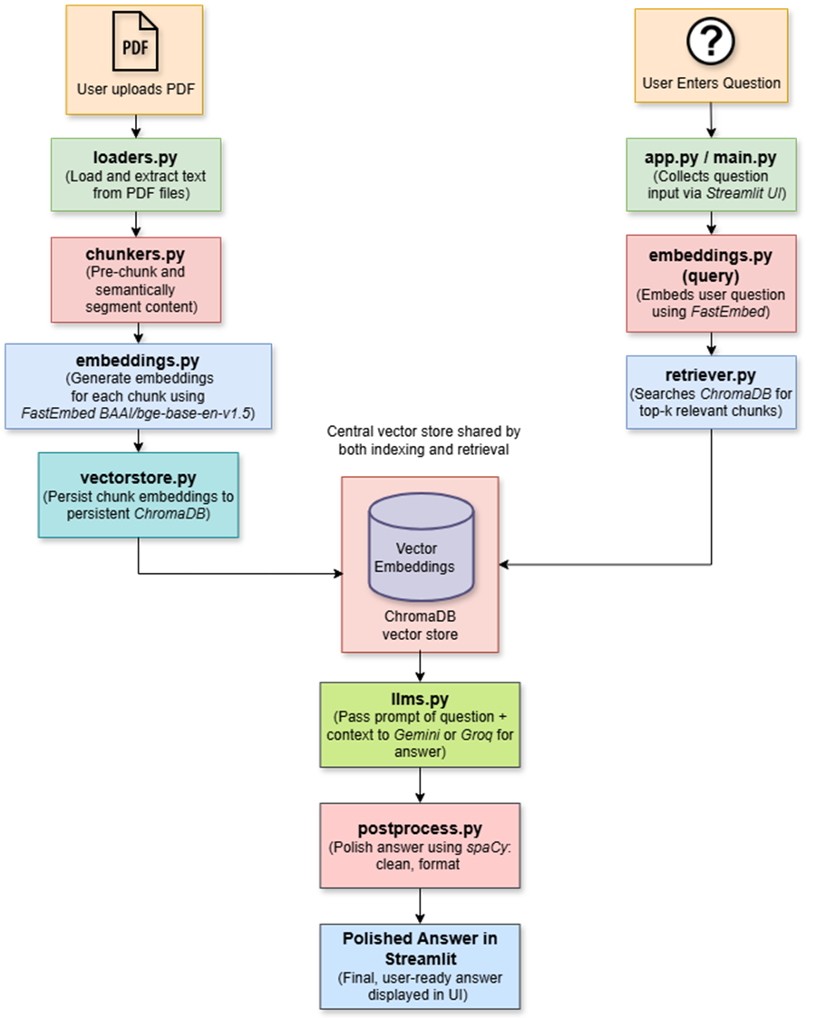
Modern Modular RAG Pipeline

Slide 9

Modern Modular RAG Pipeline
Demo

Slide 10

Work Done till Mid-Semester
Developed a classic QA baseline pipeline using Sentence-BERT embeddings, FAISS retrieval, and BERT reader.
Designed and implemented a modular, LLM-powered Educational RAG system with LangChain orchestration(Groq and Gemini integration).
Integrated advanced chunking, embedding (FastEmbed/BAAI), and persistent vector storage (ChromaDB).
Built an interactive demo application for real-time QA over uploaded academic PDFs.
Conducted initial evaluations, demonstrating improved answer quality and user experience with the modern pipeline.

Slide 11

Road Ahead
Explore local LLMs (Ollama) for privacy/deployment
Better question generation & context expansion
Automated Question Generation from Academic Documents
Advanced PDF Parsing using LlamaParse
Comprehensive Evaluation with RAGAS
user feedback & scalability

Slide 12
Thank You !

